Slide 1
PDB-07-001 Covid-19. General Guidance
PARTNER.SHIP.REDEFINED.

Slide 2
COVID 19. GENERAL GUIDANCE What should you know?
signs and symptoms of COVID-19 that should be self-monitored
DoC holder procedures / contingency plans that are to be followed when a person displays signs and symptoms suggestive of COVID-19
rules about isolation of crew members who develop symptoms suggestive of COVID-19 (check DoC holder procedures)
the need to self-isolate immediately and inform a supervisor or manager if symptoms emerge on the job
the higher risk that COVID-19 disease will be severe among vulnerable groups including people over 60, anyone of any age with a chronic disease (such as cardiovascular disease, diabetes or respiratory disease) and immunocompromised individuals
hand hygiene, respiratory etiquette and social distancing.
Source of info: WHO – Promoting public health measures in response to Covid-19 on cargo ships

Slide 3
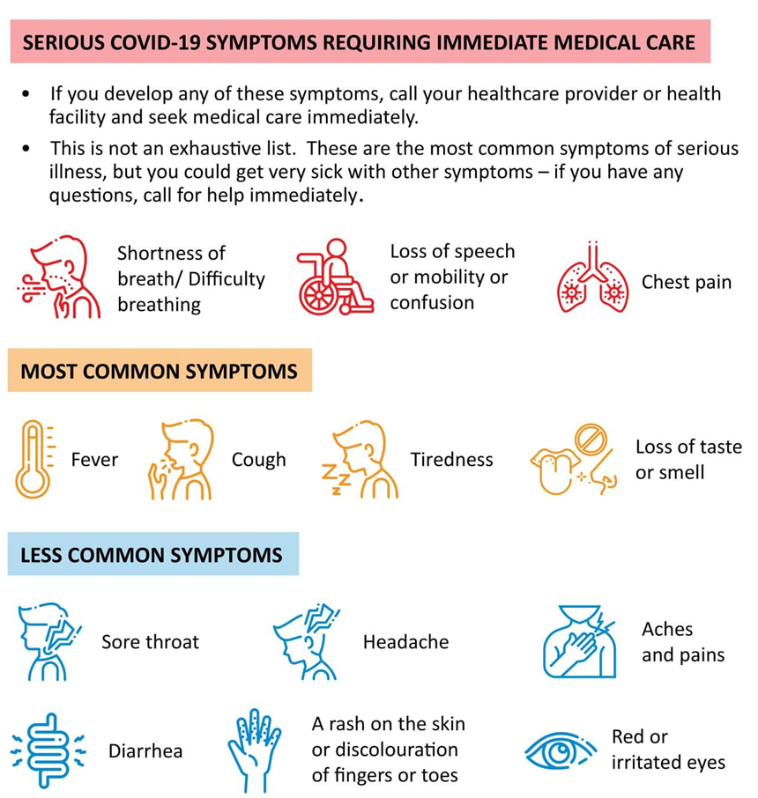
COVID 19. GENERAL GUIDANCE Symptoms

Slide 4
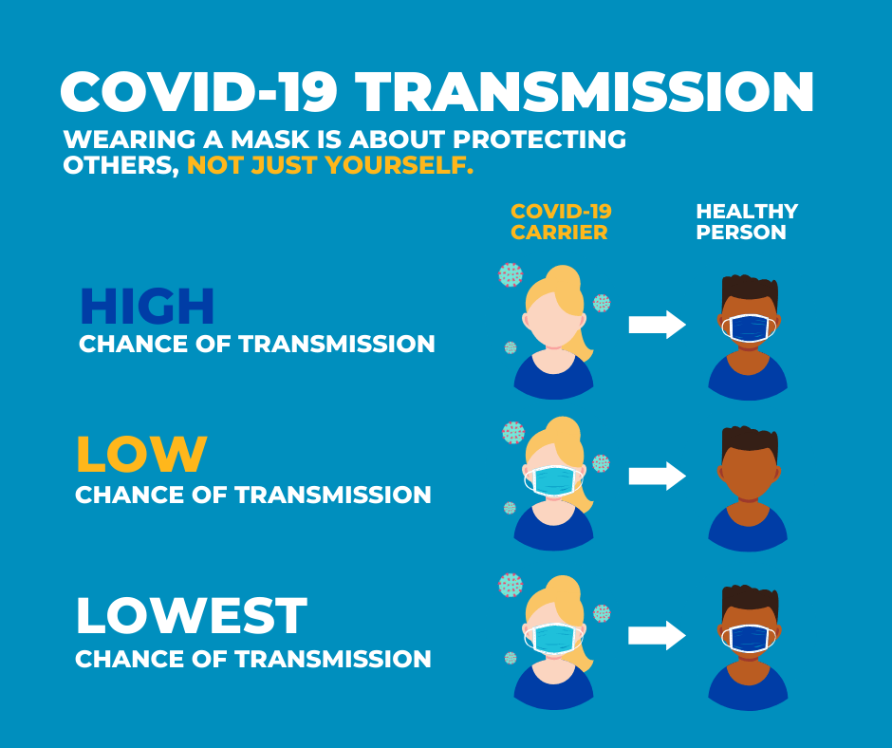
COVID 19. GENERAL GUIDANCE Importance of wearing a mask

Slide 5
COVID 19. GENERAL GUIDANCE Common Mistakes in Mask Use
Mistake: Not washing your reusable mask in between wears – have several masks and rotate
Mistake: Wearing your mask over your mouth only – COVER THE NOSE
Mistake: Touching, adjusting, and fussing with your mask – wash or sanitize hands touch the front of the mask
Mistake: Wearing a disposable mask inside out or backwards – masks are designed to be worn a specific way
Mistake: Wearing an ill-fitting mask – may need to trim beards – make sure mask fits/seals well
Mistake: Using a disposable mask for too long – limit use; leave in sun; expose to UV light
Mistake: Wearing the "wrong" mask – at least 3 layers, preferably cotton
Mistake: Not addressing or preventing skin issues underneath your mask
Mistake: Wearing a mask that is too tight – if uncomfortable, you will constantly adjust or take off
Mistake: Wearing a wet mask – ineffective and makes breathing difficult
Mistake: Improperly storing your mask while out – have a paper bag or a hook – do not shove in pocket or purse
Mistake: Thinking that wearing a mask means you do not have to socially distance

Slide 6
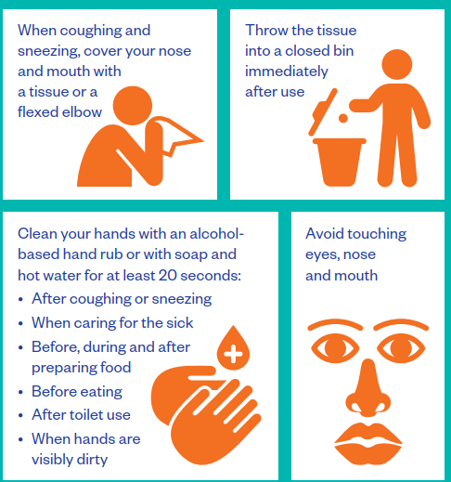
COVID 19. GENERAL GUIDANCE Protect yourself & others from getting sick

Slide 7
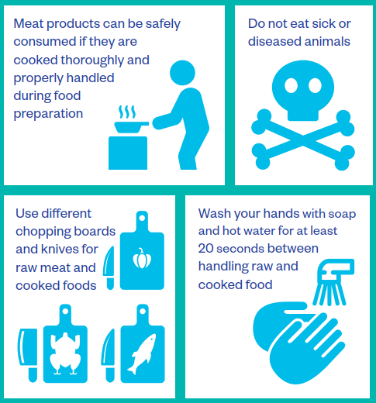
COVID 19. GENERAL GUIDANCE Practice food saftey

Slide 8
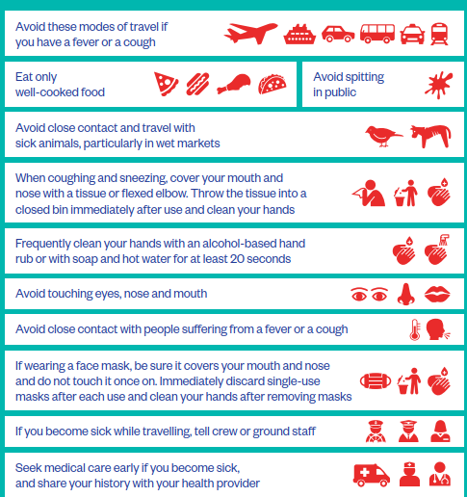
COVID 19. GENERAL GUIDANCE Stay healthy while travelling

Slide 9
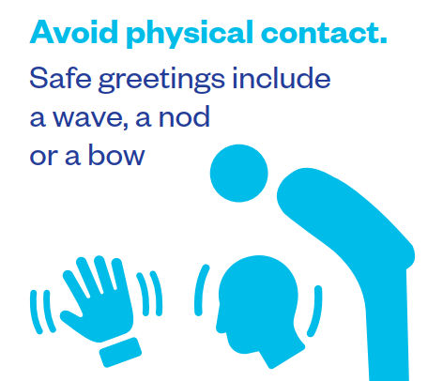
COVID 19. GENERAL GUIDANCE How to safely greet others

Slide 10
COVID 19. GENERAL GUIDANCE Shipboard care for people with suspected / confirmed Covid-19

Slide 11
COVID 19. GENERAL GUIDANCE Shipboard care for people with suspected / confirmed Covid-19

Slide 12
COVID 19. GENERAL GUIDANCE Shipboard care for people with suspected / confirmed Covid-19

Slide 13
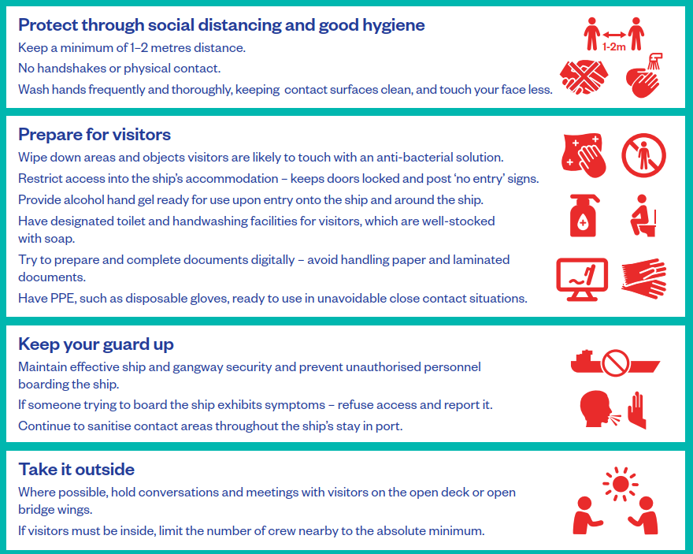
COVID 19. GENERAL GUIDANCE Protecting everyone during ship visits

Slide 14
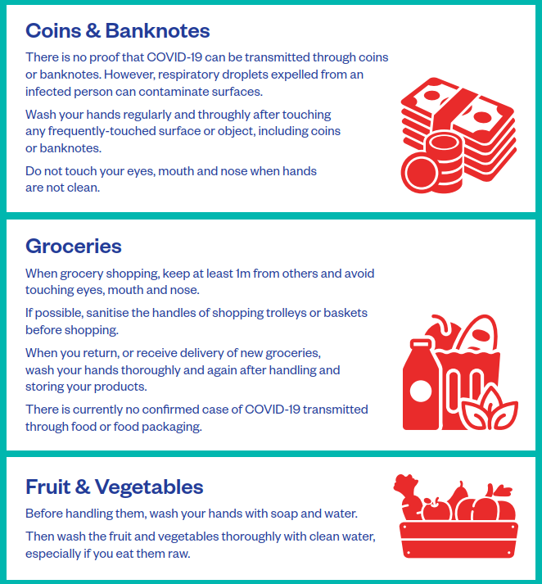
COVID 19. GENERAL GUIDANCE Care when shopping

Slide 15
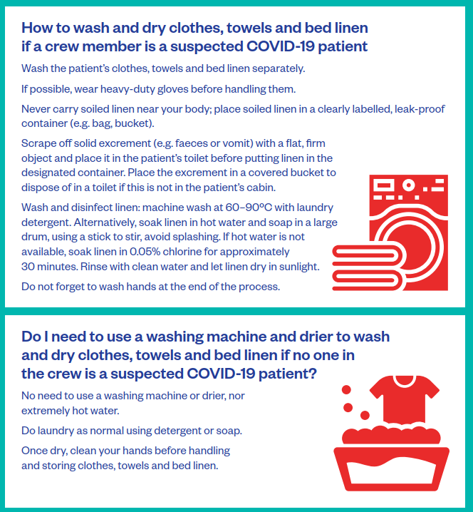
COVID 19. GENERAL GUIDANCE How to deal with laundry

Slide 16
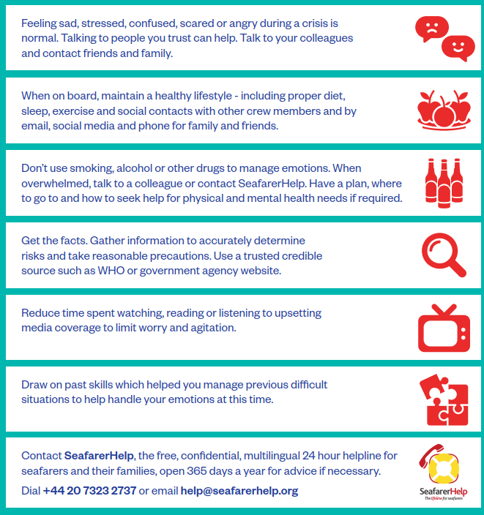
COVID 19. GENERAL GUIDANCE Coping with stress

Slide 17
THANK YOU!

